Slide 1

React JS
COSMOS

Slide 2

Introduction
JavaScript Library: React.js is a JavaScript library for building user interfaces, mainly for single-page applications.
Component-Based: It enables the creation of reusable UI components, promoting modularity and maintainability.
COSMOS

Slide 3

Introduction
Virtual DOM: React uses a Virtual DOM to optimize performance by minimizing direct manipulation of the real DOM.
Declarative: React allows developers to describe what the UI should look like based on the app's state, simplifying development and debugging.
COSMOS

Slide 4

Commands
node -v : Is use to check version of node.
npm –v : Is use to check version of npm.
npx create-react-app <name>: Is use to create react project.
npm start : Is use to run react app
COSMOS

Slide 5

Project structure
public/: Contains static assets like index.html and images, which are publicly accessible.
src/: Holds all source code, including React components, styles, and utilities.
index.js: The entry point where the app is rendered to the DOM.
App.js: Main component that acts as the root of the app.
COSMOS

Slide 6
Project structure
components/: A directory for reusable UI components.
assets/: Stores static files like images, fonts, etc.
styles/: Contains global or component-specific CSS or styling files.
node_modules/: Contains all project dependencies installed via npm or yarn.
COSMOS

Slide 7
Project structure
package.json: Configuration file for project metadata, dependencies, and scripts.
public/index.html: The HTML file that serves as a template for the app.
COSMOS

Slide 8

What if node_module deleted?
Use below command : npm install
COSMOS

Slide 9

Components in react
React Components: Reusable building blocks that define how the UI should appear.
Functional Components: Simple, stateless components that are written as JavaScript functions.
Class Components: Older components that use ES6 classes, allowing state and lifecycle methods.
COSMOS

Slide 10
Components in react
Stateful Components: Components that manage internal state using hooks or class-based methods.
Stateless Components: Components that rely solely on props for rendering and do not manage state.
Higher-Order Components (HOCs): Functions that enhance or modify the behavior of existing components.
COSMOS

Slide 11

What is JSX?
JSX (JavaScript XML): A syntax extension for JavaScript used in React to describe UI structure.
HTML-Like Syntax: JSX allows you to write HTML-like code within JavaScript.
React Elements: JSX is transformed into React elements that React can render to the DOM.
COSMOS

Slide 12
What is JSX?
Supports JavaScript Expressions: You can embed JavaScript expressions inside curly braces {} within JSX.
Component Rendering: JSX is used to define how components should render UI in React.
Requires Babel: JSX needs to be transpired to regular JavaScript using tools like Babel before it can be executed by the browser.
COSMOS

Slide 13
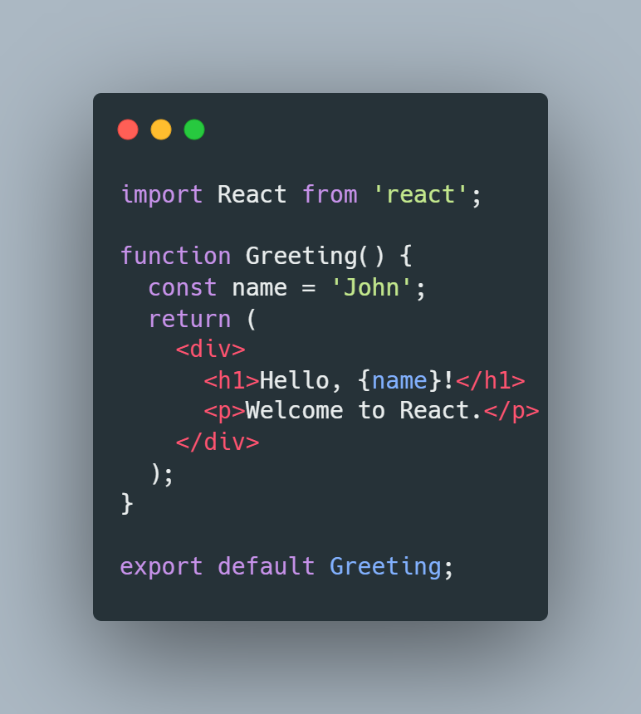

JSX Example
COSMOS

Slide 14

What is state?
State in React: A built-in object that stores data or information about the component.
Dynamic: State can change over time and trigger re-rendering of the component.
Managed within Components: Each React component can have its own state.
COSMOS

Slide 15
What is state?
Mutable: State can be updated using functions like setState (class components) or useState (functional components).
Used for Interactivity: It allows components to respond to user input, events, or other changes in the application.
Local to Component: State is local to the component unless lifted up to a parent component or shared via context or state management libraries.
COSMOS

Slide 16

What is props?
Props in React: Short for "properties," props are inputs passed from a parent component to a child component.
Read-Only: Props are immutable within the child component; they cannot be modified by the child.
Used for Data Transfer: They allow data to flow from a parent component to a child, enabling communication between components.
COSMOS

Slide 17
What is props?
Functionality: Props can be used to pass dynamic content (e.g., text, numbers, functions) into child components.
Component Customization: Props allow you to customize components by passing different values, making them reusable.
Default Props: Components can define default values for props, ensuring they have values if not explicitly provided by the parent.
COSMOS

Slide 18

Conditional rendering
Conditional Rendering in React: The ability to render different UI elements based on certain conditions or state.
Using JavaScript Expressions: You can use JavaScript logic (like if, ternary operators, or logical operators) within JSX to decide what should be displayed.
State-Driven: It often depends on component state, props, or other dynamic values to change the UI.
COSMOS

Slide 19
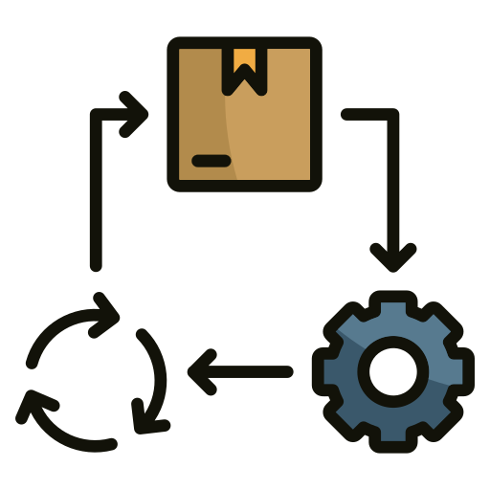
Lifecycle methods
componentDidMount(): Called once after the component has been rendered and added to the DOM, ideal for data fetching or setup tasks.
shouldComponentUpdate(): Determines if a component should re-render in response to changes in state or props (used for optimization).
componentDidUpdate(): Called after a component has updated due to changes in state or props, useful for responding to state changes.
COSMOS

Slide 20
Lifecycle methods
componentWillUnmount(): Called just before the component is removed from the DOM, ideal for cleanup tasks like canceling network requests or removing event listeners.
React Hooks: In functional components, lifecycle behaviors are handled using hooks like useEffect, which combines componentDidMount, componentDidUpdate, and componentWillUnmount in one function.
COSMOS

Slide 21

useEffect Hook
useEffect Hook in React: A built-in hook that allows you to perform side effects in functional components.
Side Effects: Operations like data fetching, DOM manipulation, or timers that don’t directly relate to rendering UI but are necessary for the component's behavior.
Runs After Render: useEffect runs after the component renders, making it ideal for tasks that need to occur after the component's output is displayed.
COSMOS

Slide 22
useMemo Hook
useMemo Hook in React: A hook that memorizes the result of a computation, optimizing performance by avoiding unnecessary recalculations.
Performance Optimization: useMemo is used to memoize expensive calculations or functions, ensuring they only recompute when specific dependencies change.
Avoids Recalculation: It helps prevent unnecessary recalculations of values on every render, improving performance in larger applications
COSMOS

Slide 23

What is map()?
map() Function in React: A JavaScript array method used to iterate over arrays and transform or display elements dynamically in JSX.
Iterates Over Arrays: The map() function is commonly used to loop through arrays and return new arrays or JSX elements.
Transforms Data: It transforms each item in an array into a new form (e.g., rendering a list of components from an array of data).
COSMOS

Slide 24
What is map()?
Returns a New Array: map() does not modify the original array, it creates and returns a new array.
Used in JSX: Frequently used in React to render lists of items dynamically within the UI.
COSMOS

Slide 25
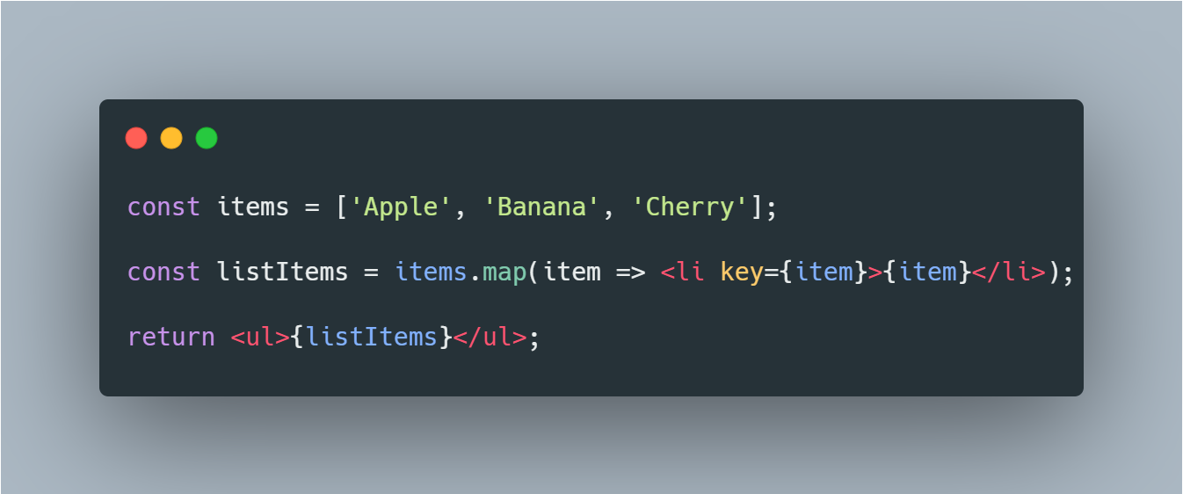
map() Example
COSMOS

Slide 26

What is Fragment?
Fragment in React: A built-in component used to group multiple elements without adding extra nodes to the DOM.
No Extra DOM Node: Fragments don't create a new wrapper element in the DOM, helping to keep the DOM structure clean.
Grouping Elements: It allows returning multiple JSX elements from a component without needing an extra parent element like <div>.
COSMOS

Slide 27
What is Fragment?
Shorthand Syntax: React provides a shorthand syntax <>...</>, making it more concise than using <React.Fragment>...</React.Fragment>.
Use Cases: Particularly useful when rendering lists or multiple elements in a component that don't need to be wrapped in an additional HTML tag.
COSMOS

Slide 28

What is Ref?
ref in React: A special attribute in React used to reference and directly interact with DOM elements or React components.
Direct Access: ref provides a way to access and modify the properties of a DOM element or React component directly.
Used for Imperative Code: It’s often used for actions like focusing an input, measuring the size of an element, or triggering animations.
COSMOS

Slide 29
What is Ref?
useRef Hook: In functional components, useRef is used to create a reference to a DOM element or a value that persists across renders.
createRef in Class Components: In class components, createRef is used to create a reference.
Not for State Management: It should not be used as a replacement for state, as it doesn't trigger re-renders.
COSMOS

Slide 30

What is Routing?
Routing in React: A mechanism to navigate between different views or pages in a single-page React application (SPA).
React Router: The most commonly used library for handling routing in React applications.
URL Mapping: Routes map specific URLs to corresponding components that should be displayed.
COSMOS

Slide 31

Working with APIs
API (Application Programming Interface): A set of protocols, tools, and definitions that allow different software applications to communicate with each other.
Communication Interface: APIs define how different software systems can interact by specifying requests and responses.
Data Exchange: They allow data to be transferred between systems, such as a web server and a client application.
COSMOS

Slide 32
API methods
GET: Fetches data from the server. Used for retrieving information or reading resources.
POST: Sends data to the server to create a new resource. Used for submitting form data, creating new entries, etc.
PUT: Sends data to the server to partially update an existing resource. More efficient than PUT for making partial updates.
DELETE: Deletes a resource from the server. Used when removing items or data.
COSMOS

Slide 33

Congratulations on completing your React JS course! You've gained valuable skills in building dynamic and interactive user interfaces. Keep practicing and exploring new features
COSMOS

